Slide 1
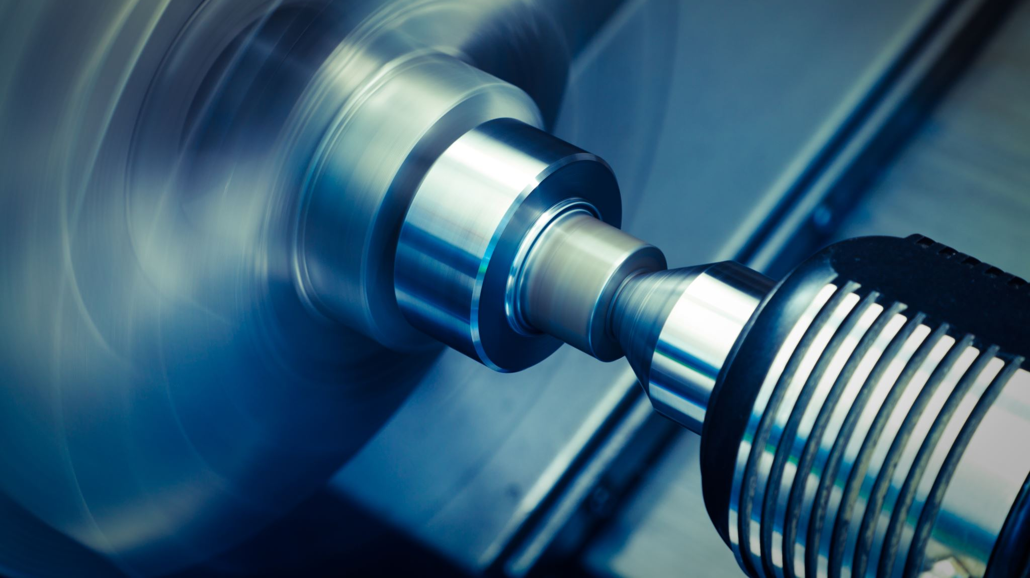
Process Validation of IACV Screw: Eric Ng -Tech 4945

Slide 2
What is process validation?
“Process Validation is defined as the collection and evaluation of data, from the process design stage throughout production, which establishes scientific evidence that a process is capable of consistently delivering quality products.”
Process Validation is an analysis tool that is used in engineering for design and quality improvement with how to improve upon processes, design of a product, or the quality of the product itself.

Slide 3
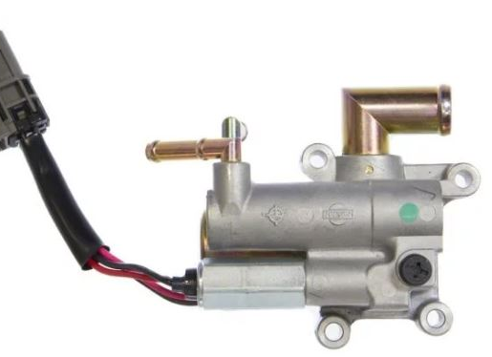
What is an IACV Screw?
IACV or Idle Air Control Valve Screw
Simply put it is an adjustment device that allows a certain amount of air to pass through the valve which allows an engine to idle at the correct RPMs (rotation per minute); this screw is more commonly seen on older vehicles which rely on the use of a physical screw.

Slide 4
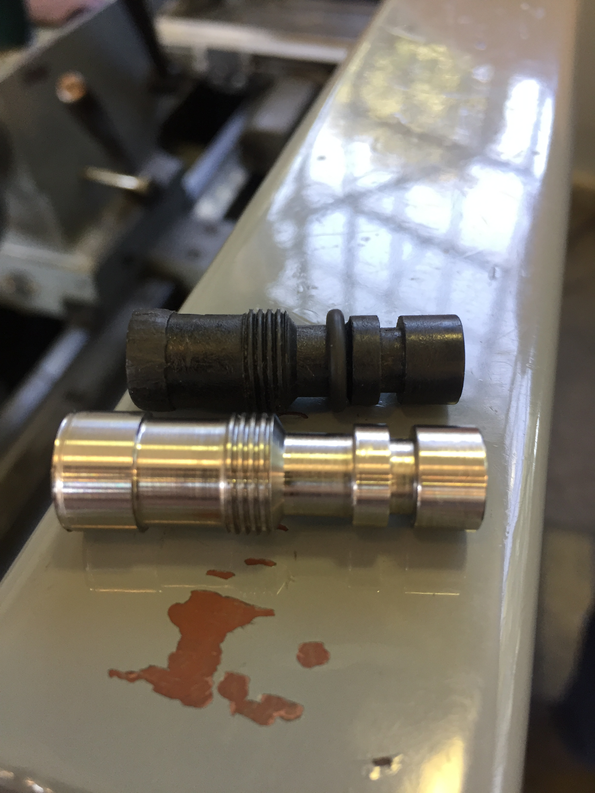
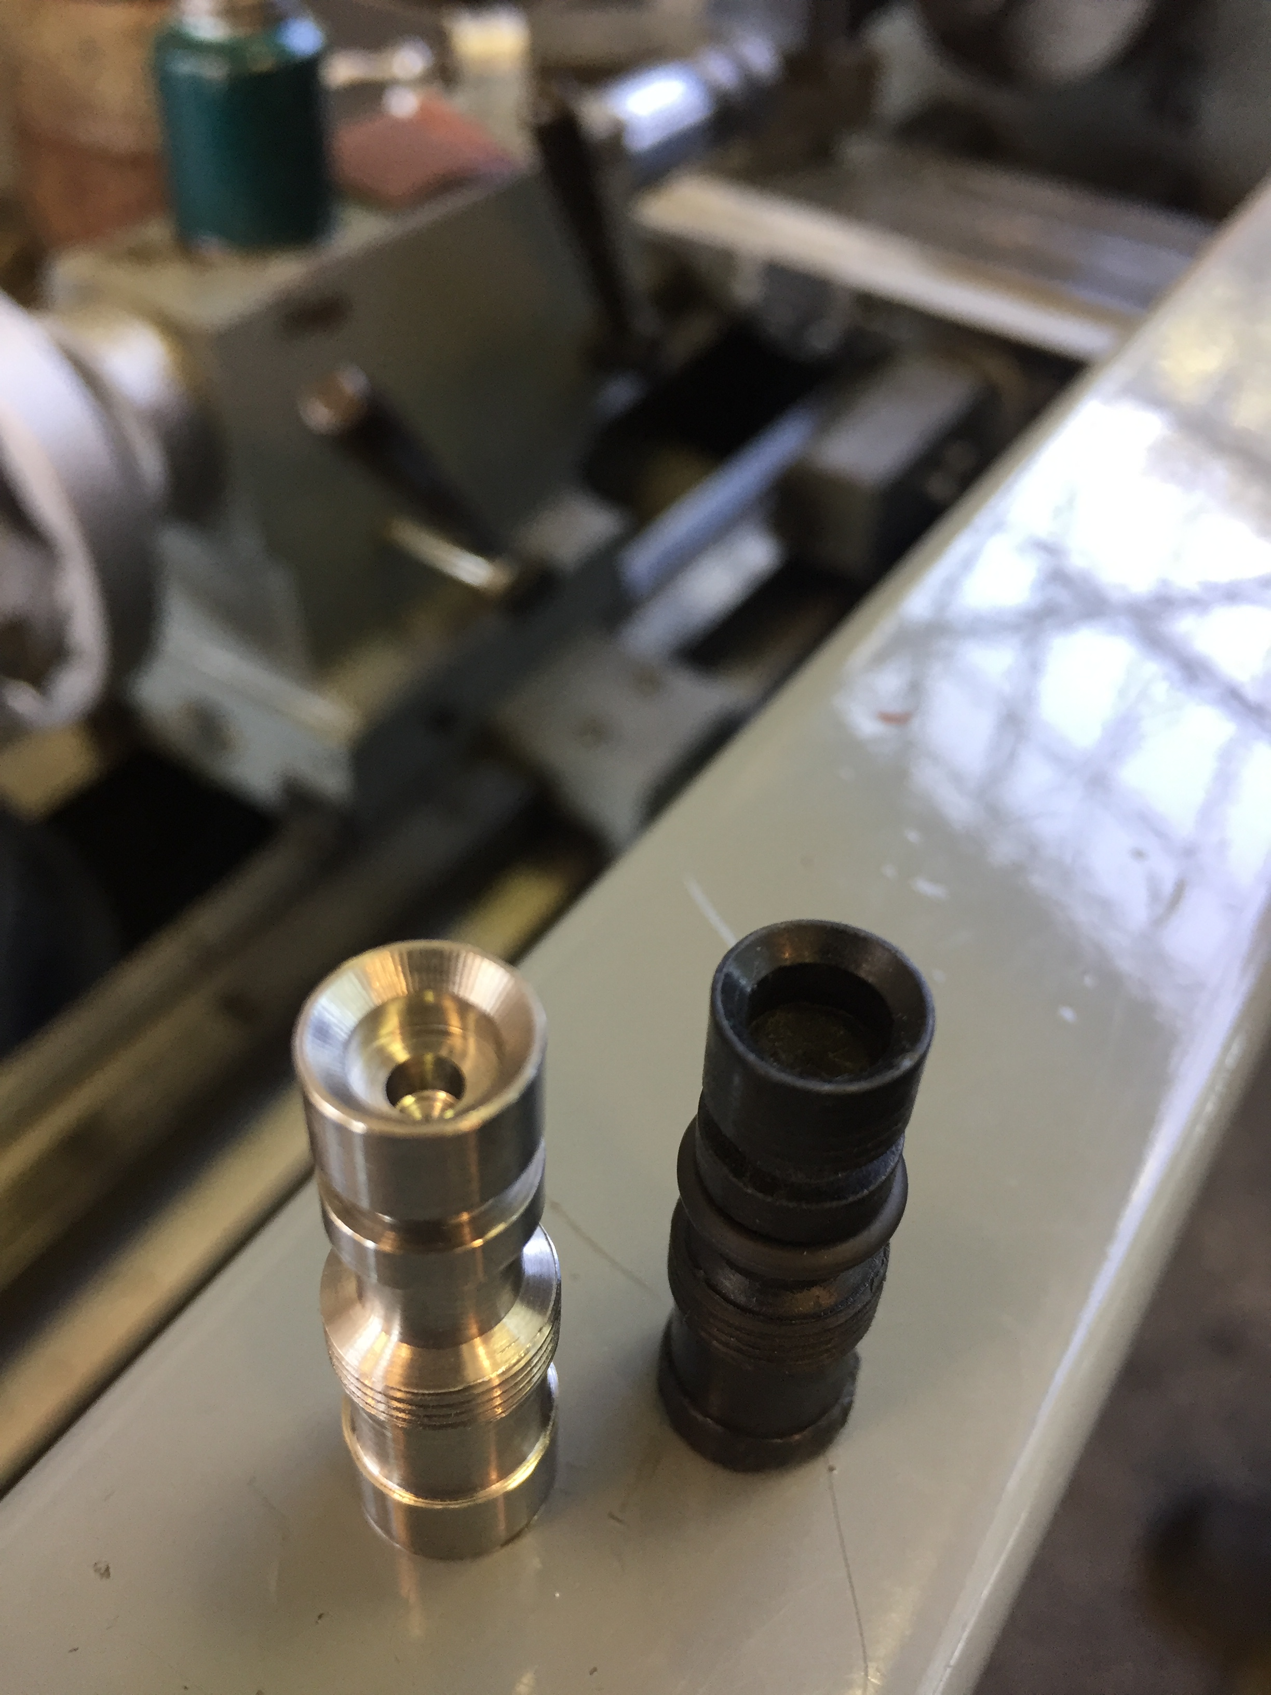

Slide 5
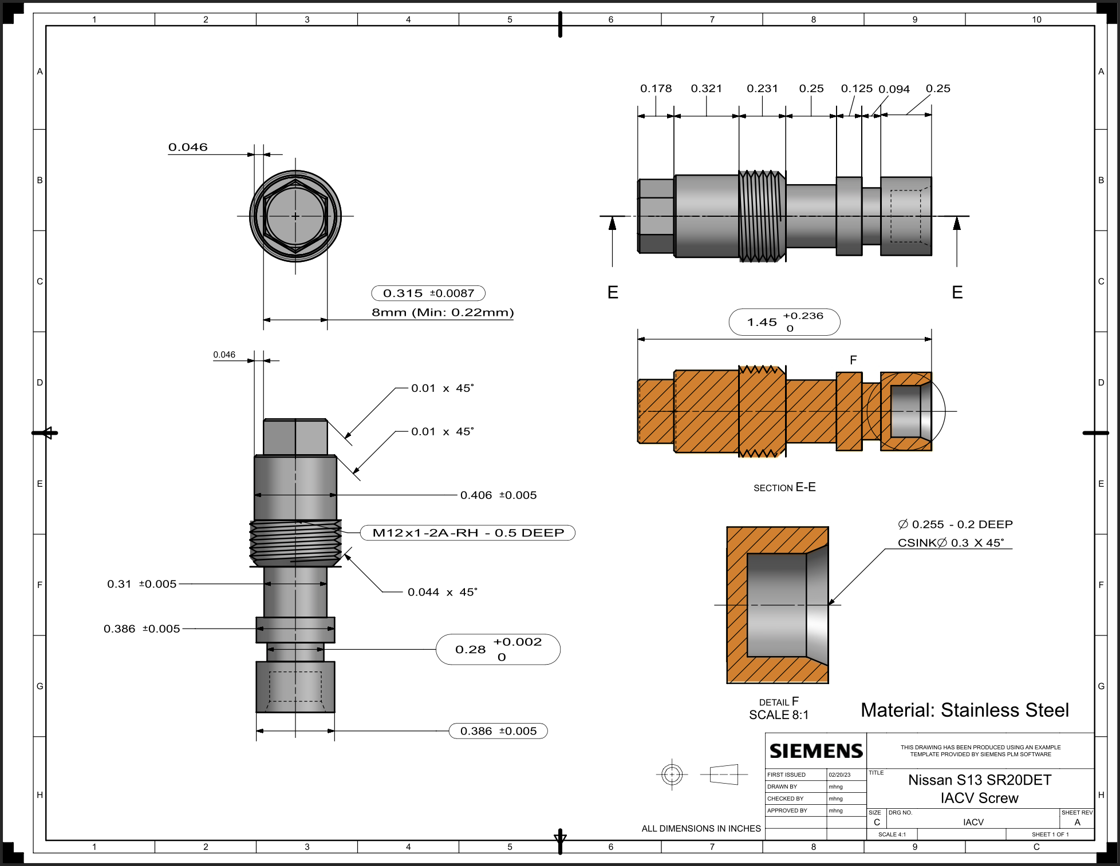
CN 1
CN 5
CN2
CN 3
CN 4

Slide 6
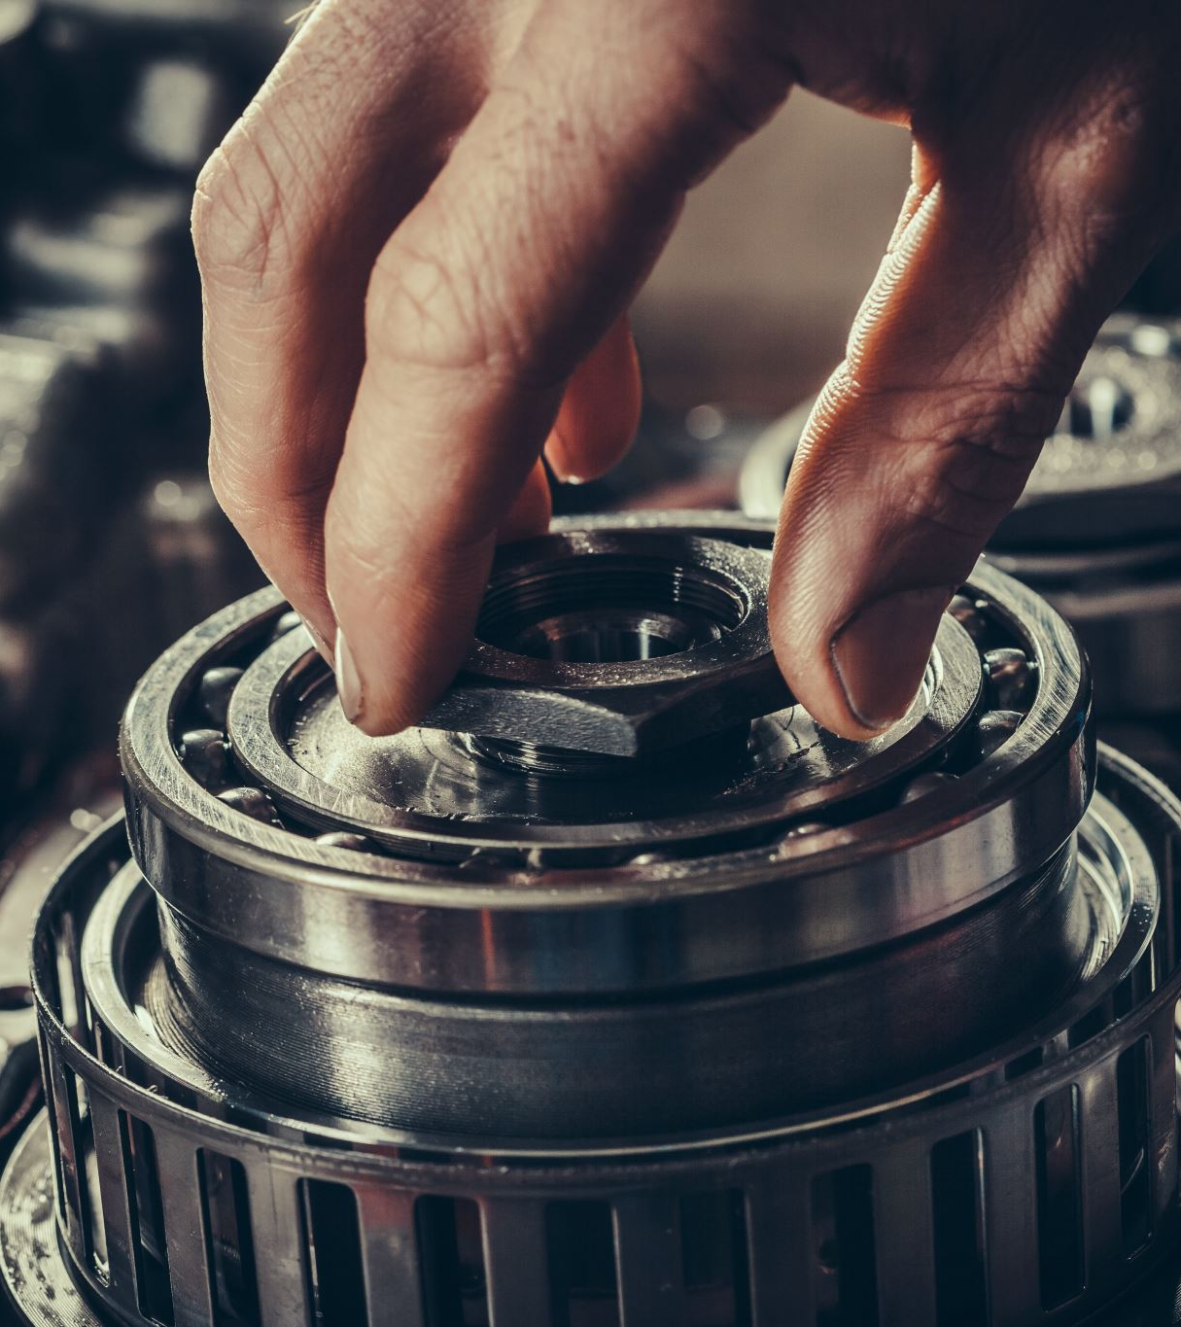
What was completed?
All machining completed
All dimensions completed
Excel data completed

Slide 7
AISI 4140 alloy steel – Chemical Composition
Element | Content (%)
Chromium, Cr | 0.80 - 1.10
Manganese, Mn | 0.75 - 1.0
Carbon, C | 0.380 - 0.430
Silicon, Si | 0.15 - 0.30
Molybdenum, Mo | 0.15 - 0.25
Sulfur, S | 0.040
Phosphorous, P | 0.035
Iron, Fe | Balance

Slide 8
Physical Properties
Properties | Metric | Imperial
Density | 7.85 g/cm³ | 0.284 lb/in³
Melting point | 1416°C | 2580°F

Slide 9
Mechanical Properties
Properties | Metric | Imperial
Tensile strength | 655 MPa | 95000 psi
Yield strength | 415 MPa | 60200 psi
Bulk modulus (typical for steel) | 140 GPa | 20300 ksi
Shear modulus (typical for steel) | 80 GPa | 11600 ksi
Elastic modulus | 190-210 GPa | 27557-30458 ksi
Poisson's ratio | 0.27-0.30 | 0.27-0.30
Elongation at break (in 50 mm) | 25.70% | 25.70%
Hardness, Brinell | 197 | 197
Hardness, Knoop (converted from Brinell hardness) | 219 | 219
Hardness, Rockwell B (converted from Brinell hardness) | 92 | 92
Hardness, Rockwell C (converted from Brinell hardness. Value below normal HRC range, for comparison purposes only) | 13 | 13
Hardness, Vickers (converted from Brinell hardness) | 207 | 207
Machinability (based on AISI 1212 as 100 machinability) | 65 | 65

Slide 10
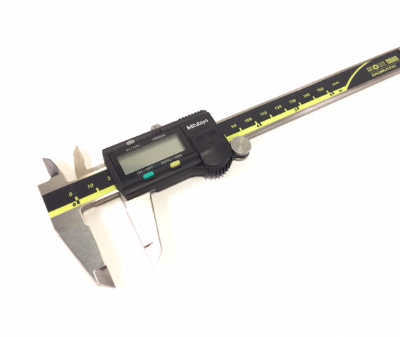
Digital calipers

Slide 11
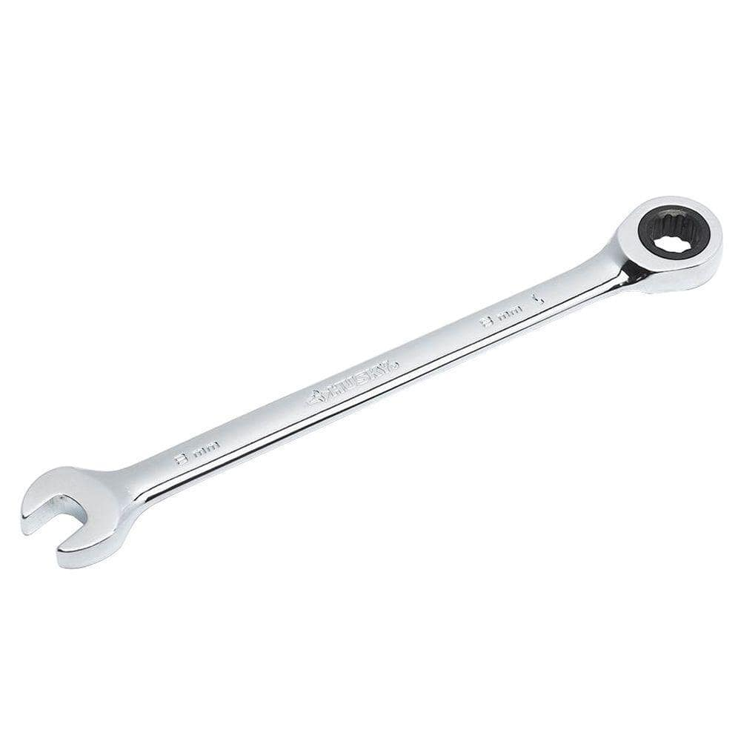
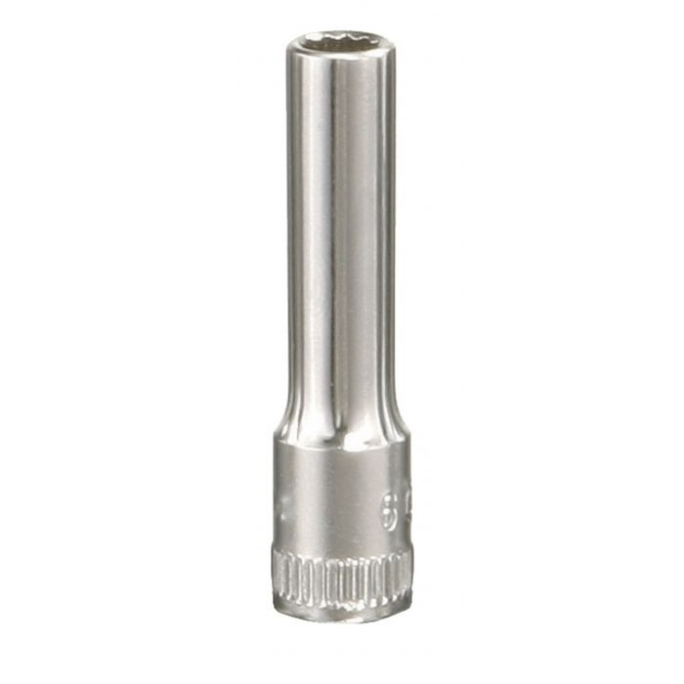
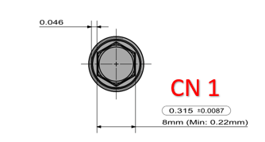

Slide 12
Std dev. | 0.00227
USL | 0.324
LSL | 0.306
Cp | 1.279850081
CpK USL | 1.594500325
CpK LSL | -0.965199838

Slide 14
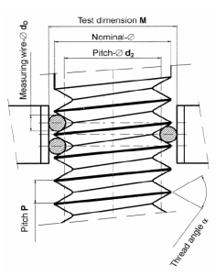
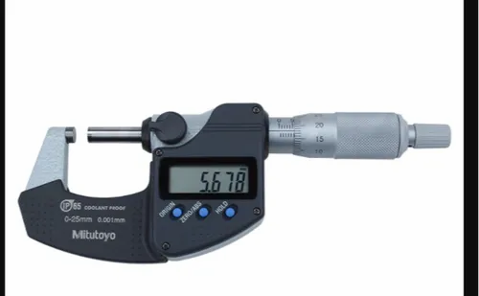
3 Wire measuring method

Slide 15
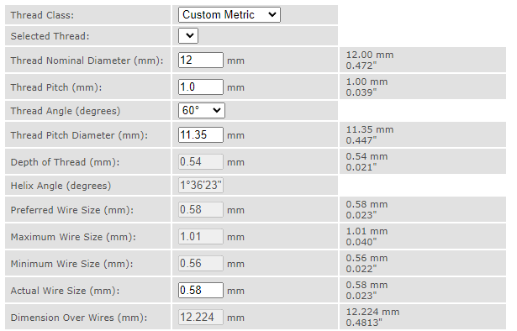

Slide 16
Std dev. | 0.00815
USL | 0.511
LSL | 0.451
Cp | 1.227291073
CpK USL | 2.129895475
CpK LSL | -0.324686672

Slide 19
Std dev. | 0.00627
USL | 0.282
LSL | 0.280
Cp | 0.053180296
CpK USL | 0.538007333
CpK LSL | 0.43164674

Slide 22
Std dev. | 0.00969
USL | 0.391
LSL | 0.381
Cp | 0.171955064
CpK USL | 0.393203913
CpK LSL | 0.049293785

Slide 24
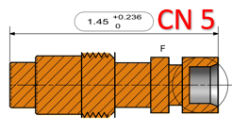

Slide 25
Std dev. | 0.02496
USL | 1.686
LSL | 1.450
Cp | 1.577235173
CpK USL | 2.678401987
CpK LSL | -0.476068359

Slide 27
Problems/issues that arose
The CP and CPK did not come to the ideal value of 1
The parts were closer to the LSL, or they were out of spec
The CNC machine is used by others as well at this project
Solution
Rechecking program and offsets of part
Reset all tools and check for chipped tooling
Ensure no one else is using the CNC machine during the duration of a rerun of the IACV Screws

Slide 28
Works Cited
https://www.azom.com/article.aspx?ArticleID=6769
https://www.cgtk.co.uk/metalwork/calculators/screwmeasurement
https://www.fast-rite.com/wp-content/uploads/Fast-Rite_TechnicalSpecsForFasteners_20181210.pdf
https://mt-swiss.com/english:3-draht-gewindemessung. asp
https://www.parker.com/content/dam/Parker-com/Literature/O-Ring-Division-Literature/ORD-5700.pdf
https://www.pda.org/docs/default-source/website-document-library/chapters/presentations/southern-california/2018-validation-day/process-validation--fundamentals-for-success.pdf?sfvrsn=89a5968e_4.
Quality Improvement

Slide 29
Questions?

